Slide 1
Nuclear Fuel Performance
NE-533
Spring 2024

Slide 2
Last Time
We derived two analytical solutions for the stress in a pressurized cylinder
Thin walled cylinder
Thick walled cylinder
Thermal expansion is a strain that doesn’t inherently cause stress
Thermal expansion can cause stress when there is a temperature gradient
We have analytical equations for thermal stresses
in the cladding
in the fuel

Slide 3
Paper Project
Assigned papers uploaded to moodle with your name as a prefix
This will be a critical review of the paper, similar to what we do for QE2, but much shorter
15 minute presentation that summarizes what was done in the paper, provides context on why it was done, and reviews what could or should have been done, or could be done next
All presentations will be submitted via moodle, due by end of the day on Mar. 20
Presentations will take place in-class on Mar. 21 and Mar. 26
If you have a specific paper that you would like to review and applies to this topic field, present it to me and I will consider it

Slide 4
thermal expansion

Slide 5
The gap changes as a function of time
Both the pellet and the cladding swell
But, as the gap decreases, the temperature changes, which again makes the gap change
The solution using the analytical equations is iterative, due to the dependence of the gap size and temperature

Slide 6
Example

Slide 7
Calculate the steady state temperature profile in the rod, including thermal expansion
LHR = 200 W/cm, δ⁰_{gap} = 30 μm, R_{f} = 0.6, T_{co} = 600 K, T_{EXP,0} = 373 K, k_{gap} = 0.0026 W/cm-K, t_{C}= 0.06 cm, α_{f} = 11.0e-6 1/K, α_{C} = 7.1e-6 1/K
So, T_{IC} = 600 + 18.7 = 618.7 K, T_{s} = 679.9 K, T₀ = 1210.5 K
First, we will deal with expansion in the cladding
Av(R_{c}) = 0.6 + 30e-4 + 0.06/2 = 0.633 cm
Av(T_{C}) = (600+618.7)/2 = 609.4 K
ΔR_{c} = 0.633*7.1e-6*(609.4 – 373) = 0.0011 cm
$$= ΔR_{c}−ΔR_{f}$$

Slide 8
Calculate the steady state temperature profile in the rod, including thermal expansion
Second, we deal with the fuel
Av(Tf) = (1210.5 + 680)/2 = 945.25 K
ΔR_{f} = 0.6*11e-6*(945.3 – 373) = 0.00378 cm
The total change in the gap is 0.0011 – 0.0038 = -0.0027
However, that means the gap is smaller and so our temperatures were wrong!

Slide 9
This calculation is repeated until the gap width stops changing significantly
The change in the gap does NOT affect the coolant or outer cladding temperatures, just the gap and fuel temperatures
Does fuel centerline temp go up or down with correction?
Iteration | δ_{gap} (cm) | T_{s} (K) | T₀ (K)
0 | 0.003 | 701 | 1232
1 | 0.00066 | 644 | 1174
2 | 0.00097 | 652 | 1182
3 | 0.00094 | 651 | 1181
4 | 0.00094 | 651 | 1181

Slide 10
last bit of Mechanics

Slide 11
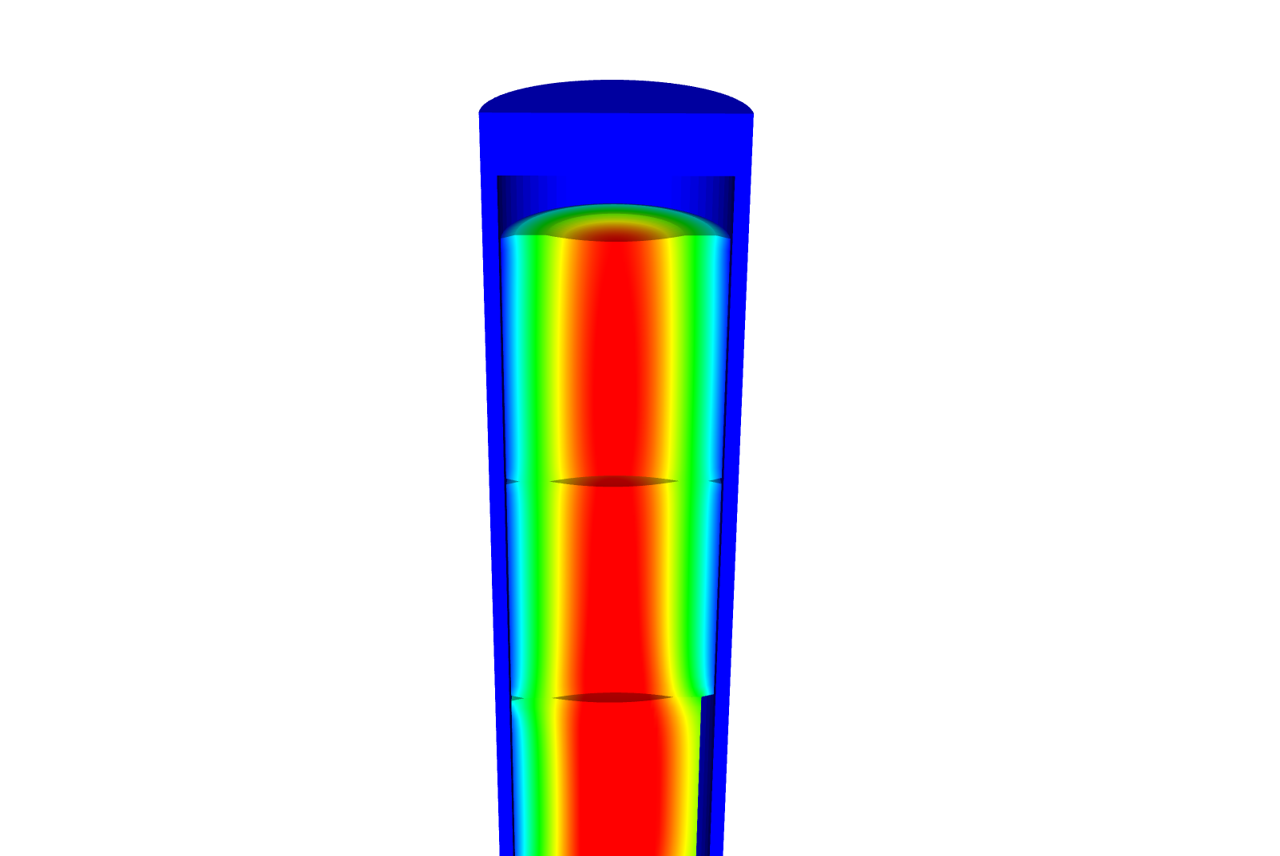
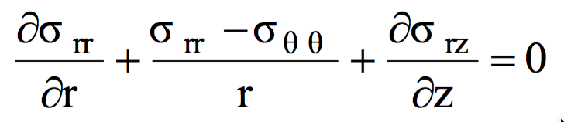
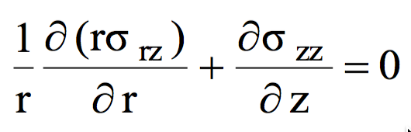
Relating Displacements to Stress
We have been determining the stress due to some internal pressure (or temperature)
Often, the information more readily obtainable are the displacements
Utilizing the previous equations, can use displacement to stress relationships for our geometry

Slide 12
Assuming problem is axisymmetric

Slide 13
Solve for the stress from the strain
Assume isotropic materials
Can perform matrix multiplication for the calculation of the stress, given the displacements

Slide 14
Further simplify the problem to be 1D
No change in Z:

Slide 15
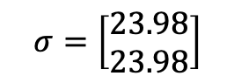
Determine the strain and stress in the pellet for 1D case
Assume the radial displacement in the fuel pellet is u_{r}(r) = 0.05r cm.
What is the strain tensor? At the outer edge:
We are dealing with UO₂, so E = 200 GPa and ν = 0.345
C₁₁ = E (1 – ν)/((1+ν)( 1–2 ν)) = 200*(1–0.345)/(1.345*(1–2*.345)) = 314.2 Gpa
C₁₂ = E ν/((1+ν)( 1–2 ν)) = 200*0.345/(1.345*(1–2*.345)) = 165.5 Gpa
Now we can calculate the stresses
σ_{rr} = 0.05*314.2 + 0.05*165.5 = 23.98 GPa
σ_{θθ} = 0.05*165.5 + 0.05*314.2 = 23.98 GPa
$$σ=\left[\begin{matrix}23.98 \\ 23.98\end{matrix}\right]$$

Slide 16
Example problem
Compute the stress and strain tensors in the center and at the outer edge (r = 0.5 cm) in 1D axisymmetric coordinates in a fuel pellet with u_{r}(r) = r²/5. C₁₁ = 314.2 Gpa, C₁₂ = 165.5 Gpa.
First, calculate the strain tensor
ε_{rr} = u_{r,r} = 2r/5
ε_{θθ} = u_{r}/r = r/5
At the center there is no strain; at the outer edge
To calculate the stress, convert to a strain vector and multiply by elastic constant matrix
The stress in the center is zero
On the outer edge
σ_{rr} = 0.2*314.2 + 0.1*165.5 = 79.4 GPa
σ_{θθ} = 0.1*314.2 + 0.2*165.5 = 64.52 GPa

Slide 17
Material Property Evolution

Slide 18
Pretty much everything we have learned so far, nothing changes once the fuel and cladding reach steady state

Slide 19
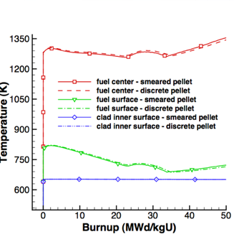
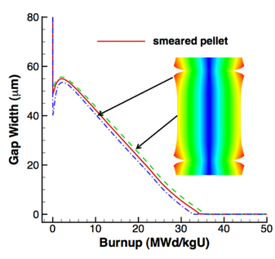
Fuel is dynamic!

Slide 20
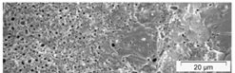
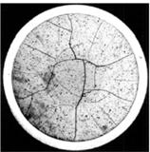
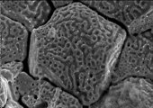


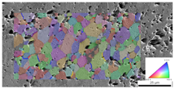
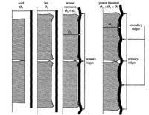
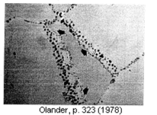
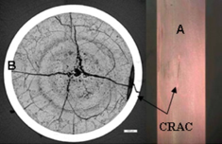
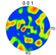
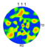
Property changes due to microstructure evolution during reactor operation must be considered
Insertion in reactor
Removal from reactor
Early life
Thermal expansion
Fracture
Point defect and fission gas generation
Fuel Densification
Mid Life
Point defect diffusion
Point defect clustering
Fission gas segregation to GB and voids
Bubble nucleation
Late life
Fission product swelling
Bubble percolation and fission gas release
Cladding creep
Fuel creep
Fuel failure
Pellet/cladding interaction
Cladding corrosion
Cladding fracture
Fuel Fabrication
Sintered UO²
Height 2 cm
Diameter 1 cm
~10 μm grain size
Density > 95%
Brohan 2000
From Pedro Peralta, ASU
Zinkle and Singh 2000
Santana et al. 2011

Slide 21
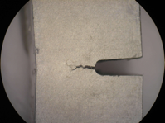
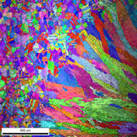
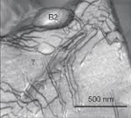
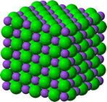
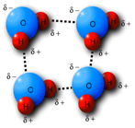
The properties and performance of a material are a result of factors across various length scales
Material properties and performance
Microstructure
Defect interactions
Crystal structure
Chemical bonds

Slide 22
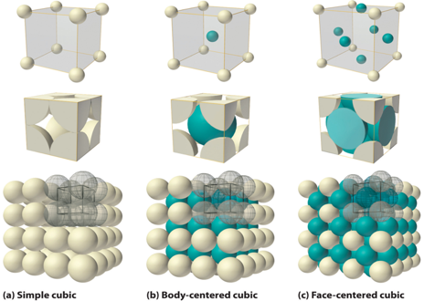
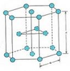
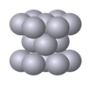
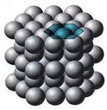
The crystal structure of a material is the shape of the ordered structure of the atoms
The atoms of many materials form an organized lattice, these are called crystalline materials. All reactor materials are crystalline.
The configuration of the atoms in the lattice impacts the properties of the material (density, thermal expansion coefficient, elastic modulus, etc.)
All major light water nuclear materials are either cubic or hexagonal
(d) Hexagonal close packed

Slide 23
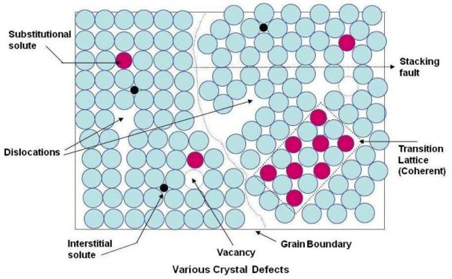
Crystalline materials
In crystalline materials, the lattices are not perfect, they have defects
Defects can be 0D, 1D, 2D, 3D
The interactions between defects seriously impact material properties and how they perform

Slide 24
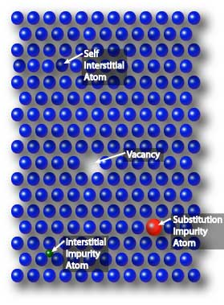
Point defects
Point defects (zero-dimensional defects) are lattice imperfections related to one or two lattice sites
There are several types of point defects
Vacancies
Self interstitial atoms (SIA)
Interstitial impurity atoms
Substitutional impurity atoms
Point defects control the mobility of atoms and, therefore influence all processes that depend on diffusion

Slide 25
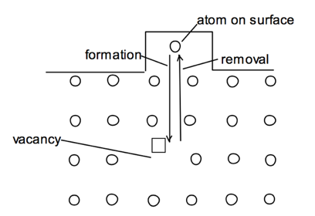
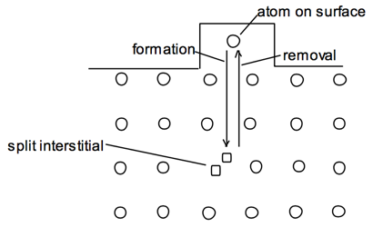
Point defects
Vacancies and interstitials form naturally in materials
Extra atoms can sit on a surface, creating a vacancy, or a surface can have a missing atom, creating a self interstitial atom (SIA)
We define the number of vacancies or interstitials in terms of a concentration
There exists an equilibrium concentration of point defects

Slide 26
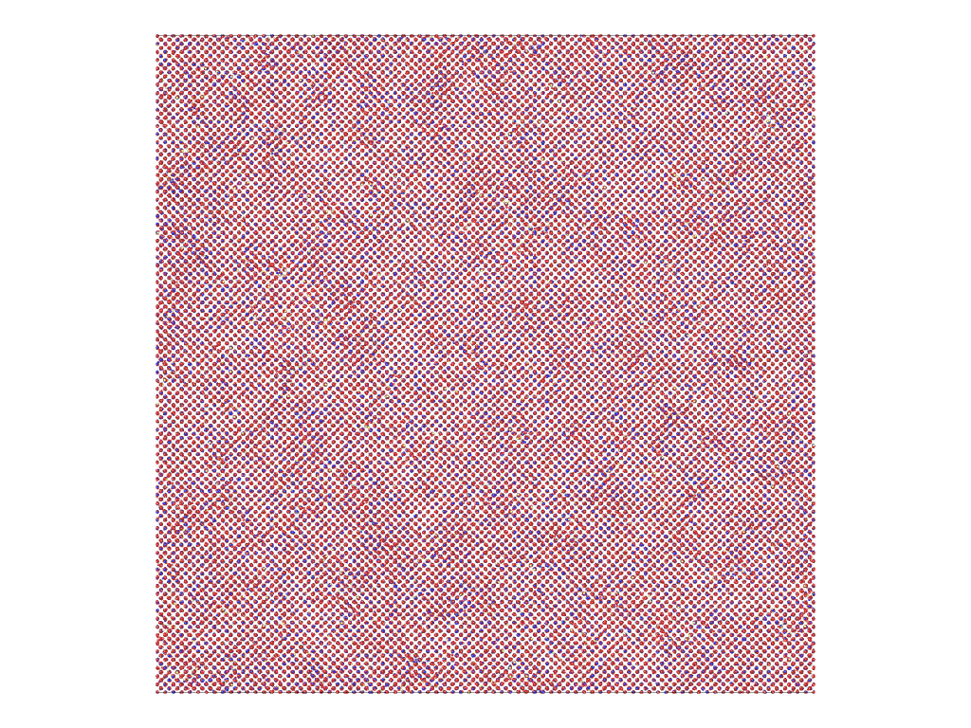
Radiation damage
Ionizing radiation can introduce defects into the crystal lattice, called radiation damage
PKA collisions create a collision cascade, which results in the generation of defects (point and clusters)

Slide 27
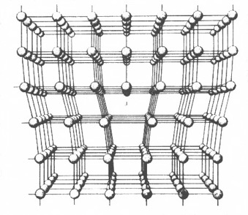
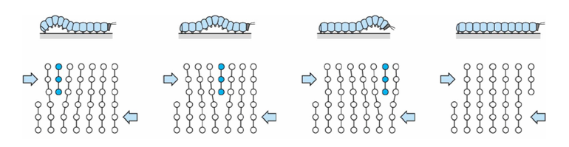
Dislocations are imperfections associated with a line of lattice sites (1D defect)
In a dislocation, an extra half plane of atoms is inserted into the lattice
When it moves, only a small number of bonds are broken at a time
Dislocation motion controls the plastic (permanent) deformation of crystalline materials

Slide 28
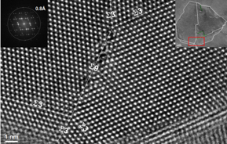
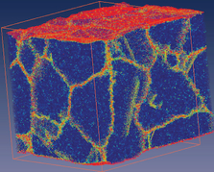
Grain boundaries
Materials are typically composed of various regions where the crystal lattice is oriented differently. These regions are called grains
When two grains meet, there is a plane of atoms that do not follow the crystal lattice called a grain boundary
Most crystalline materials are polycrystalline, not single crystal
High-res transmission eleectron microscopy can also show individual atoms (palladium)
www.knmf.kit.edu/TEM.php
Atomistic simulation of grain boundaries in 3D

Slide 29
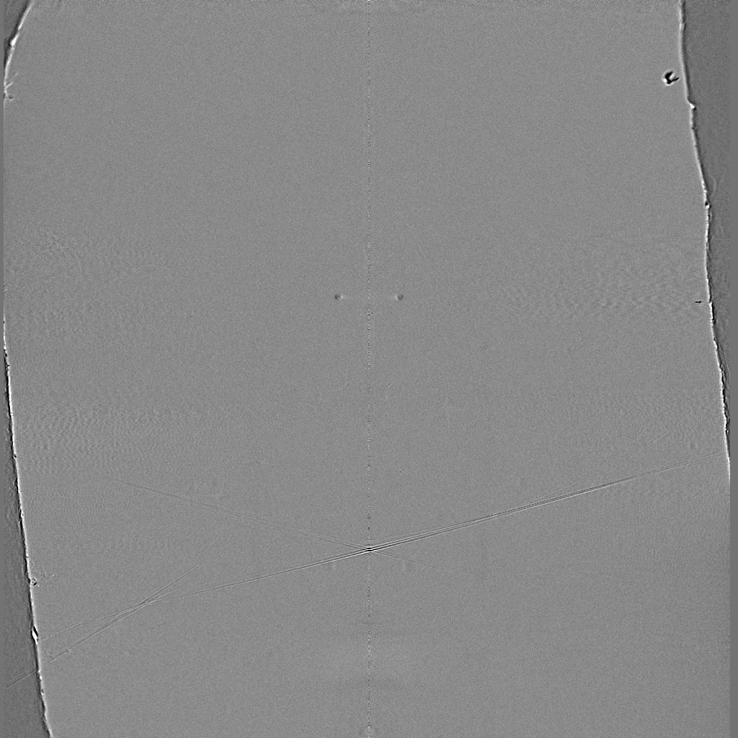
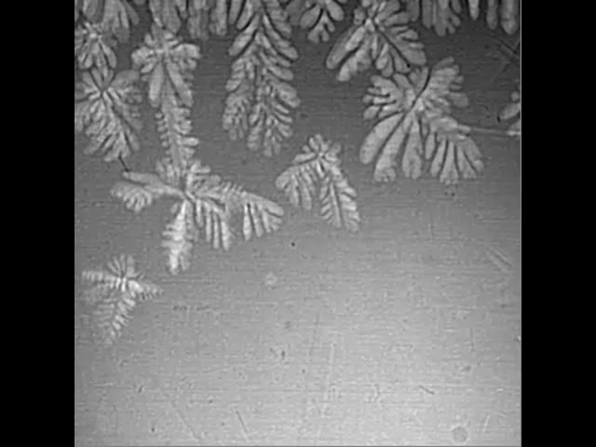
Metals are often cast, and polycrystals naturally form during casting

Slide 30
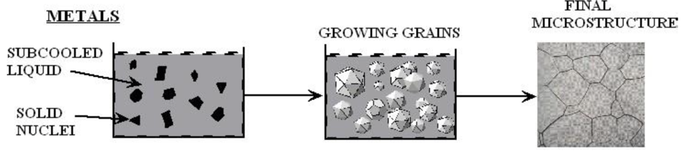
Polycrystals naturally form during casting
Solidification begins in different regions of the melt, each with a different orientation
Once the different regions meet, grain boundaries form between them

Slide 31
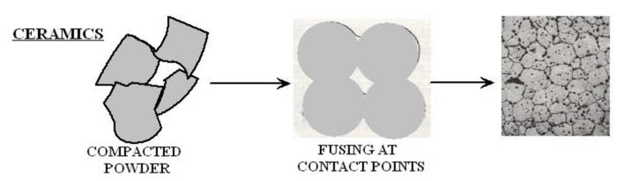
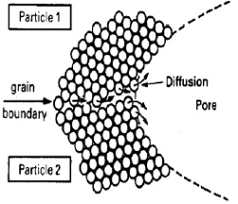
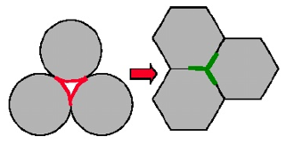
Ceramic sintering
Ceramics are typically sintered, and polycrystals also naturally form from sintering
In sintering, powders are compacted at high temperature
The particles are each oriented differently, and as they fuse, grain boundaries form
The differences between the grain orientations result in the grain boundary

Slide 32
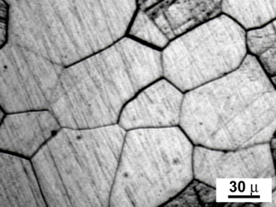
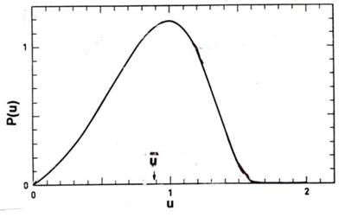
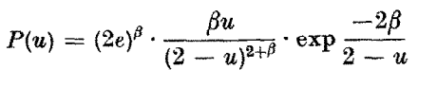
Distribution of grain sizes
In a polycrystal, there is also a distribution of grain sizes
Therefore, we commonly refer to the grain size distribution and the average grain size
The Hillert distribution is an analytical distribution for grain size
Real materials often vary from this behavior

Slide 33
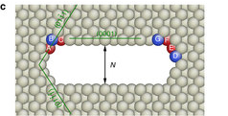
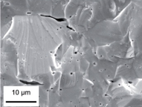
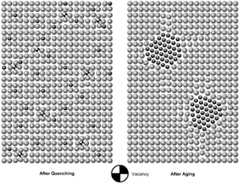
3D Defects
When point defects cluster, they form three dimensional defects
The energy of a point defects is reduced when several point defects cluster together
Larger clusters of vacancies are called voids
Clusters of impurity atoms are called precipitates

Slide 34
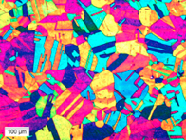
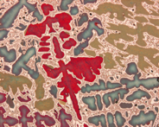
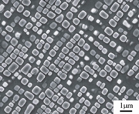
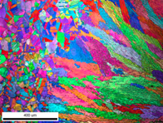
Microstructure
Material microstructure is the structure observable with 25x magnification
The microstructure includes grain structure, secondary phases, porosity, and more
The microstructure can strongly influence physical properties such as strength, toughness, ductility, hardness, corrosion resistance, high/low temperature behavior or wear resistance.
These properties in turn govern the application of these materials in industrial practice
Annealed Stainless Steel
Cast Bronze
Sintered UO2
Co-Al-W Superalloy
Friction stir welded stainless steel

Slide 35
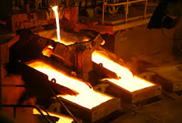


Material processing
The processes we use to make a material have a huge impact on its microstructure and properties
Casting – manufacturing process in which a liquid material is poured into a mold and then allowed to solidify
Can be used to make complex shapes
The solidified microstructure typically has properties that are far from ideal
Sintering – Forming a solid from a powder using heat and/or pressure without melting the material
Applicable to metals and ceramics
Difficult to obtain a material that is fully dense
Used to make fuel pellets
Post-fabrication processing
heat treatment
working

Slide 36
Material processing
Heat treatment: heating or cooling a material to extreme temperatures to get desired microstructure and properties
Used to control the rate of microstructure change, including diffusion, grain growth, or phase change
Annealing
heat and hold the material, which allows for any defects in the material to repair themselves
The metal is then allowed to cool back to room temperature at a slow pace to produce a more ductile crystalline structure
Quenching
heated to a temperature that transforms its internal structure, held at that temperature, then rapidly cooled
The quick cooling process locks in the high T structure, or forces phase transformation without the ability to relax stresses

Slide 37

Material processing
Working: metalworking process that plastically deforms the alloy
Cold working occurs below the recrystallization temperature, hot working occurs above
By plastically deforming the material, we are increasing the number of dislocations and dislocation barriers, increasing the yield strength
Main types of working processes:
Squeezing (rolling/extrusion/drawing)
Bending (shaping)
Shearing (slitting)

Slide 38
Summary
Gap size changes due to thermal expansion, changing temperature profile
Often have displacements instead of strains, and can solve for stress via displacements
Fuel and pellet conditions change with time due to microstructure evolution
Atoms in the fuel and cladding materials are arranged in a crystal lattice
The crystal lattice is never perfect; it has defects
Point defects, dislocations, grain boundaries, voids and precipitates
All materials have defects, radiation damage causes many more defects
Microstructure can be tailored through processing, during fabrication or post-fabrication

